Slide 1
Create Javadoc

Slide 2
Javadoc
The Javadoc is my package manual for all developers using my package
https://docs.oracle.com/javase/9/docs/api/index.html?overview-summary.html
How to write a javadoc
http://www.oracle.com/technetwork/java/javase/tech/index-137868.html
Example javadoc (basic packages in Java)
https://docs.oracle.com/javase/9/docs/api/index.html?overview-summary.html

Slide 3
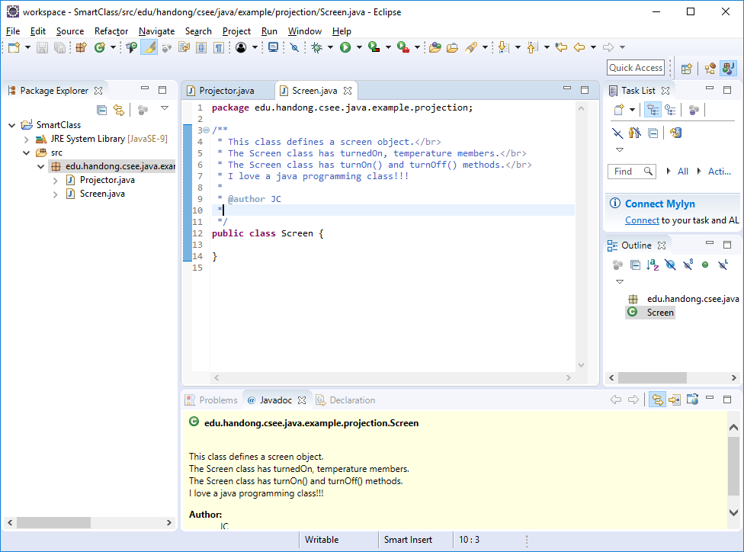
Javadoc example in a java code file

Slide 4
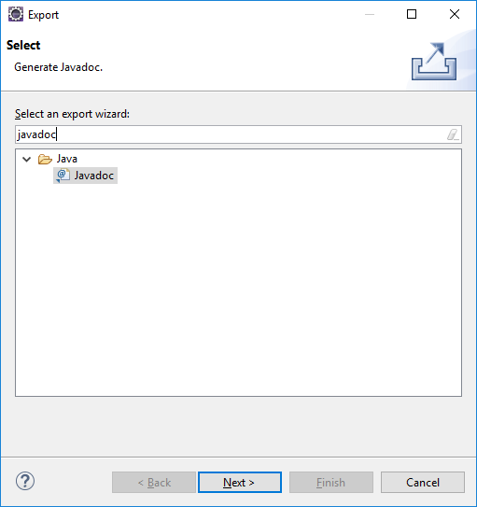
Create Javadoc in html files
Pop-up menu on my project → Export → Search 'javadoc' → Next

Slide 5
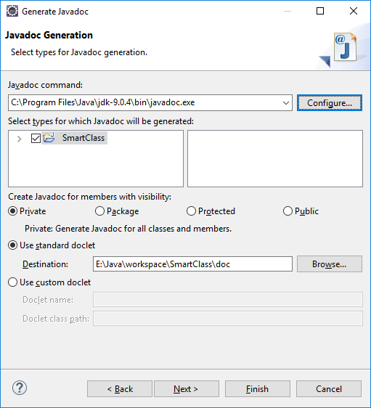
Create Javadoc in html files (2)
Put C:\Program Files\Java\jdk-9.0.4\bin\javadoc.exe (If you have a different java bin path, use the correct one.)
Choose your project
Choose Visibility as Public. (But you can choose any visibility based on your need.
Finish
Click "Yes to all"
If you have an error like "javadoc: error - cannot read Input length = 1" after "Finish" this step, check your workspace path whether it contains any korean characters. In this case, close your Eclipse and move your workspace folder into another path without Korean characters.

Slide 6
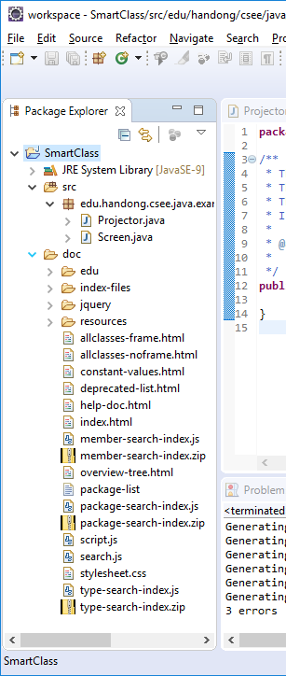
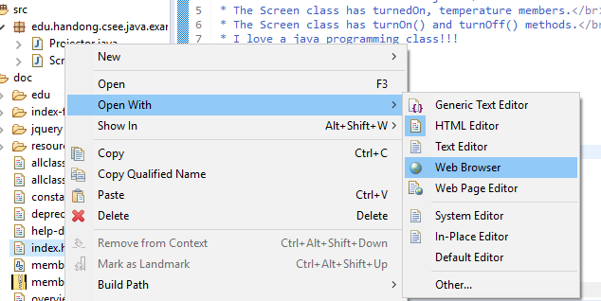
Create Javadoc in html files (3)
Now you have the 'doc' folder. Expand 'doc'
Open index.html In your web browser or a web browser in Eclipse.

Slide 7
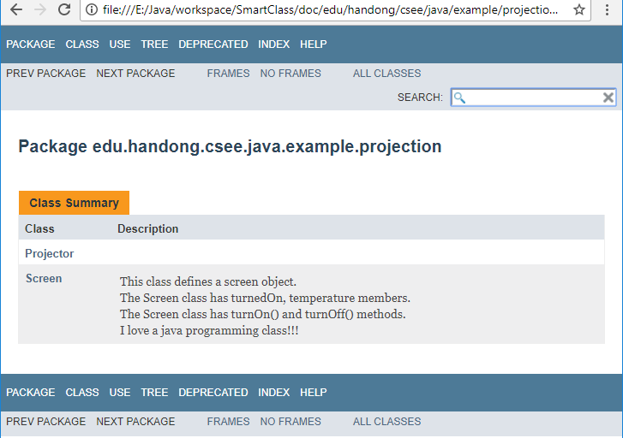
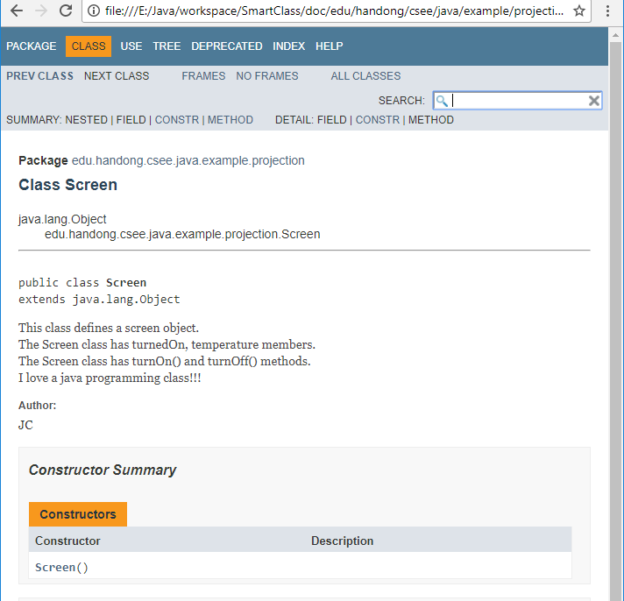
Created Javadoc

Slide 8
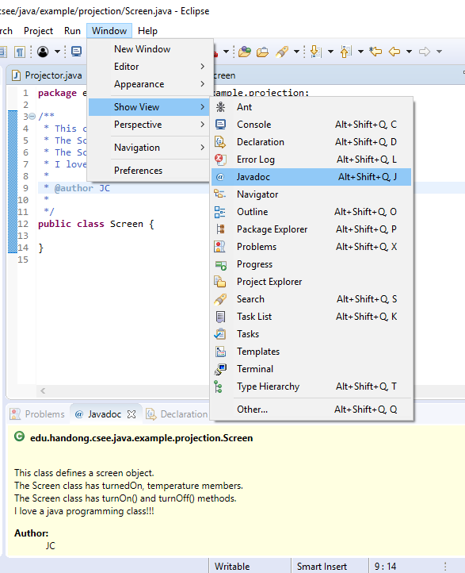
You can preview the javadoc in Eclipse

Slide 9
Javadoc tags
@author (classes and interfaces only, required)
@version (classes and interfaces only, required. See footnote 1)
@param (methods and constructors only)
@return (methods only)
@exception (@throws is a synonym added in Javadoc 1.2)
@see
@since
@serial (or @serialField or @serialData)
@deprecated (see How and When To Deprecate APIs)
http://www.oracle.com/technetwork/java/javase/tech/index-137868.html

